Slide 1
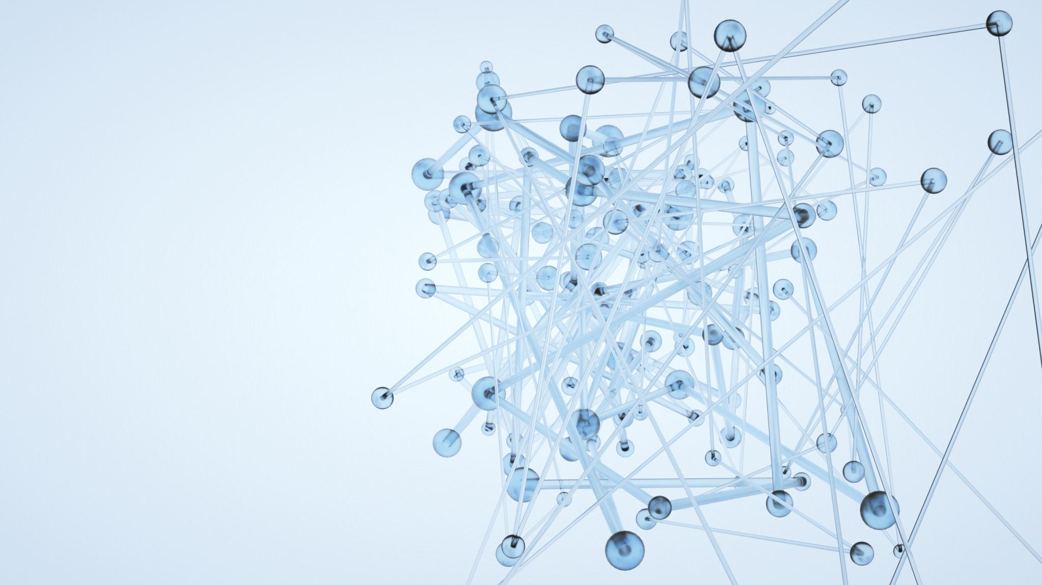
Full-Stack Application of Skin Cancer Diagnosis Based on CNN Model
By
CHIEFS

Slide 2
Contents:
Introduction
Model Formation
Training Process
Service Hosting
Experiment
Datasets
Evaluation Metrics
Experimental Results and Analysis
Conclusion

Slide 3
Introduction:
The main aspects of this work can be summarized as follows:
Design and implement a full-stack application to diagnose skin cancer with modern user experience.
Trained CNN Model with small dataset to effectively classify skin cancer.
Based on existing HAM10000 dataset, improve it with more content and build a system that constantly enrich the dataset.
Implement a chatting system that supports interactive chatting powered by Google Dialog flow service and real person customer service powered by NodeJS WebSocket

Slide 4
Model Formation:
The overall service provides contains two parts,
Training part
Service part
The training part trains a CNN model to do object detection to identify and classify skin cancers, and by collecting the adjusted feedback provided by user, the model will update itself to make better prediction.

Slide 5
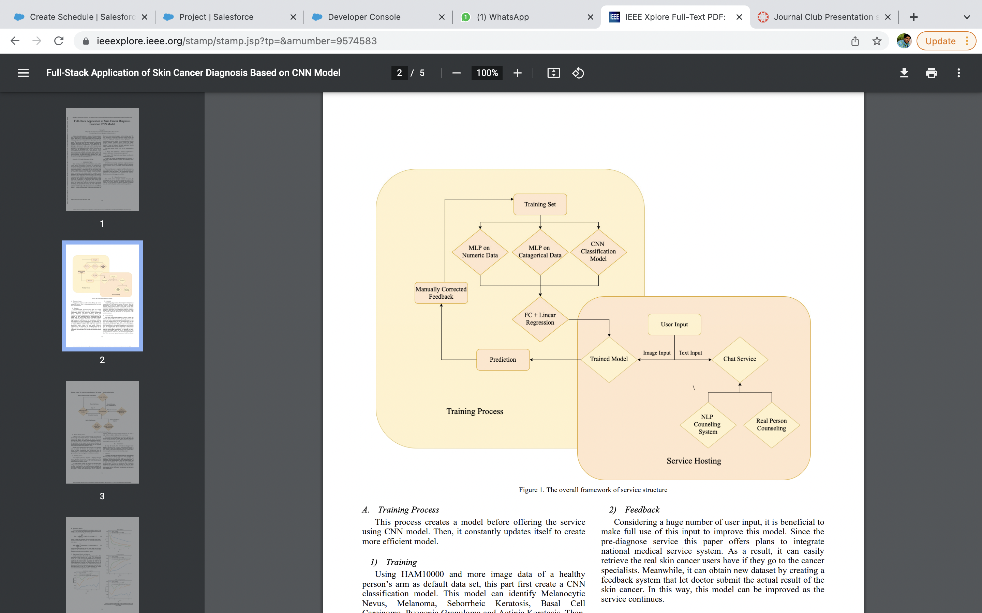

Slide 6
Training Process:
Training : Using HAM10000 and more image data of a healthy person’s arm as default data set, this part first create a CNN classification model. Then, consider the huge difference between HAM10000 and the actual input of user’s image input.
Feedback : Considering a huge number of user input, it is beneficial to make full use of this input to improve this model. Since the pre-diagnose service, this paper offers plans to integrate national medical service system. As a result, it can easily retrieve the real skin cancer users have if they go to the cancer specialists. Meanwhile, it can obtain new dataset by creating a feedback system that let doctor submit the actual result of the skin cancer. In this way, this model can be improved as the service continues.

Slide 7
Service Hosting:
This paper suggests and implement a service system that not only provide API for users to quickly get access to the model and but also host a chatting system that not only include NLP but also real person chatting system to offer a more friendly prediagnose support for users.
This part hosts a service that has been implemented by a complete front and back end. For front end, this research firstly chooses implement in iOS platform because an iOS app has a huge market and complete service that can let users take picture easily. For backend, this paper chooses the NodeJS to host the service. The hosts also use google Firebase to store users’ text and image input.

Slide 8
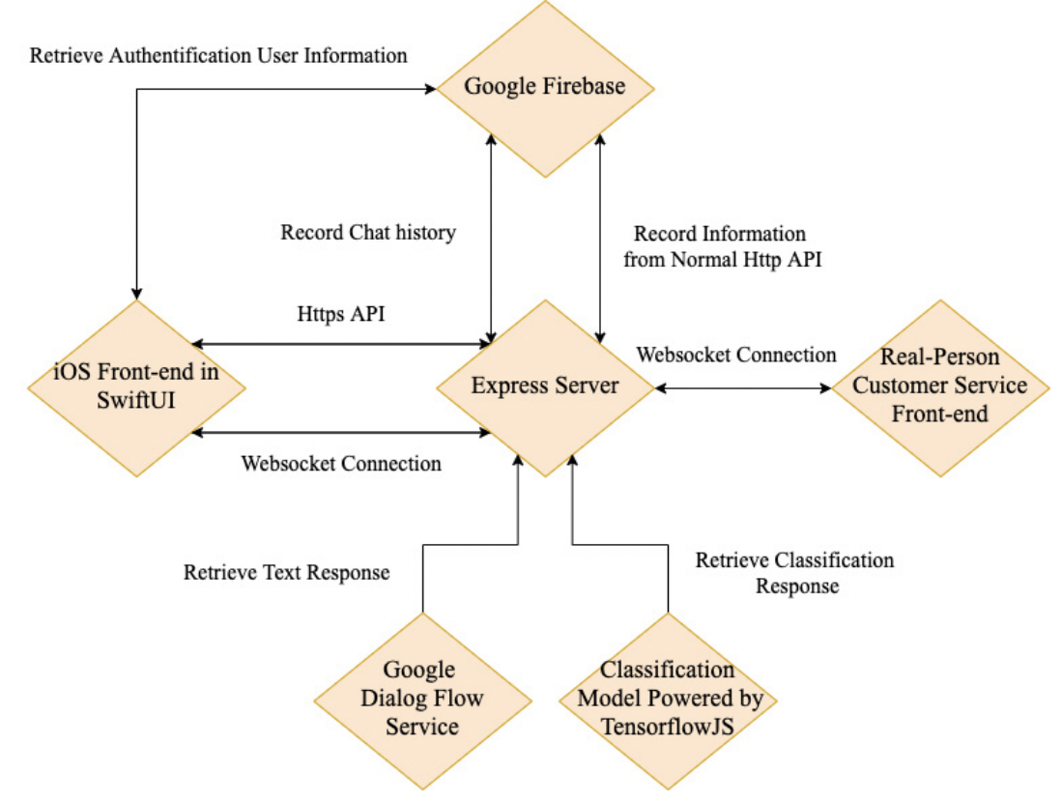

Slide 9
Model Hosting Service:
Although Keras is used to train the model, it can host this model using TensorFlowJS library to host the trained model. Users firstly upload their image to the server. The server processes the image and offers prediction using the model it hosts. Then, the server communicates with Firebase and store the prediction and the image into the system.
Finally, the server sends the result back to the frontend and the logged in user can browse their history diagnose result. Besides, logged in user can submit the feedback for any history results. The server will then communicate with Firebase and store the actual result in a separate database. Then, the developer can get new dataset by extracting data from this new database.

Slide 10
Chatting Service:
This service system also integrates a chatting service to answer questions of users that is related to skin cancer. The chatting service contains two parts: the NLP chatting system and a real person chatting system.
For NLP chatting system, this service use the Dialog flow API provided by Google. The dialog flow can not only extract meaning from input text and generate the text feedback, but also send signal back to the server to do API call.
The real person chatting system can answer questions that is not covered well in NLP system. Here, this study uses web socket in order to build separate chat room for a single user and a single customer service staff.

Slide 11
Experiment:
To train the model, this research uses Google Colab platform. Besides, Keras is used to implement CNN model, a MLP model to deal with categorized value, a MLP model to deal numeric value and a concatenate layer to combine three models together to form a one-hot encoding output.

Slide 12
Datasets:
For dataset, this study uses HAM10000 skin cancer dataset. For the graphic part that is supposed to input in CNN, this research transfers all 600*450 image to 300*225 and normalize its three-color channels. For categorical MLP, it one-hot encoded prepared gender, place that took pictures, and dx type.
For continuous MLP model, the age is normalized treated as input. To better see the training result, it separates the dataset into training set and validation set. There are 10016 entries in total, this study randomizes the order of the entries and separate the first 8000 entries as training set and the rest as the validation set.

Slide 13
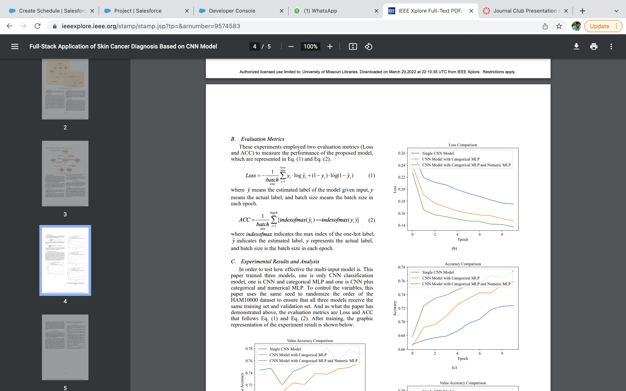
Evaluation Metrics:
These experiments employed two evaluation metrics (Loss and ACC) to measure the performance of the proposed model, which are represented in Eq. (1) and Eq. (2).
where yˆ means the estimated label of the model given input, y means the actual label, and batch size means the batch size in each epoch.
where indexofmax indicates the max index of the one-hot label, yˆ indicates the estimated label, y represents the actual label, and batch size is the batch size in each epoch

Slide 14
Experimental Results and Analysis :
In order to test how effective, the multi-input model is. This paper trained three models
Only CNN classification model
CNN and categorical MLP
CNN plus categorical and numerical MLP.
To control the variables, this paper uses the same seed to randomize the order of the HAM10000 dataset to ensure that all three models receive the same training set and validation set. And as what the paper has demonstrated above, the evaluation metrics are Loss and ACC that follows Eq. (1) and Eq. (2).

Slide 15
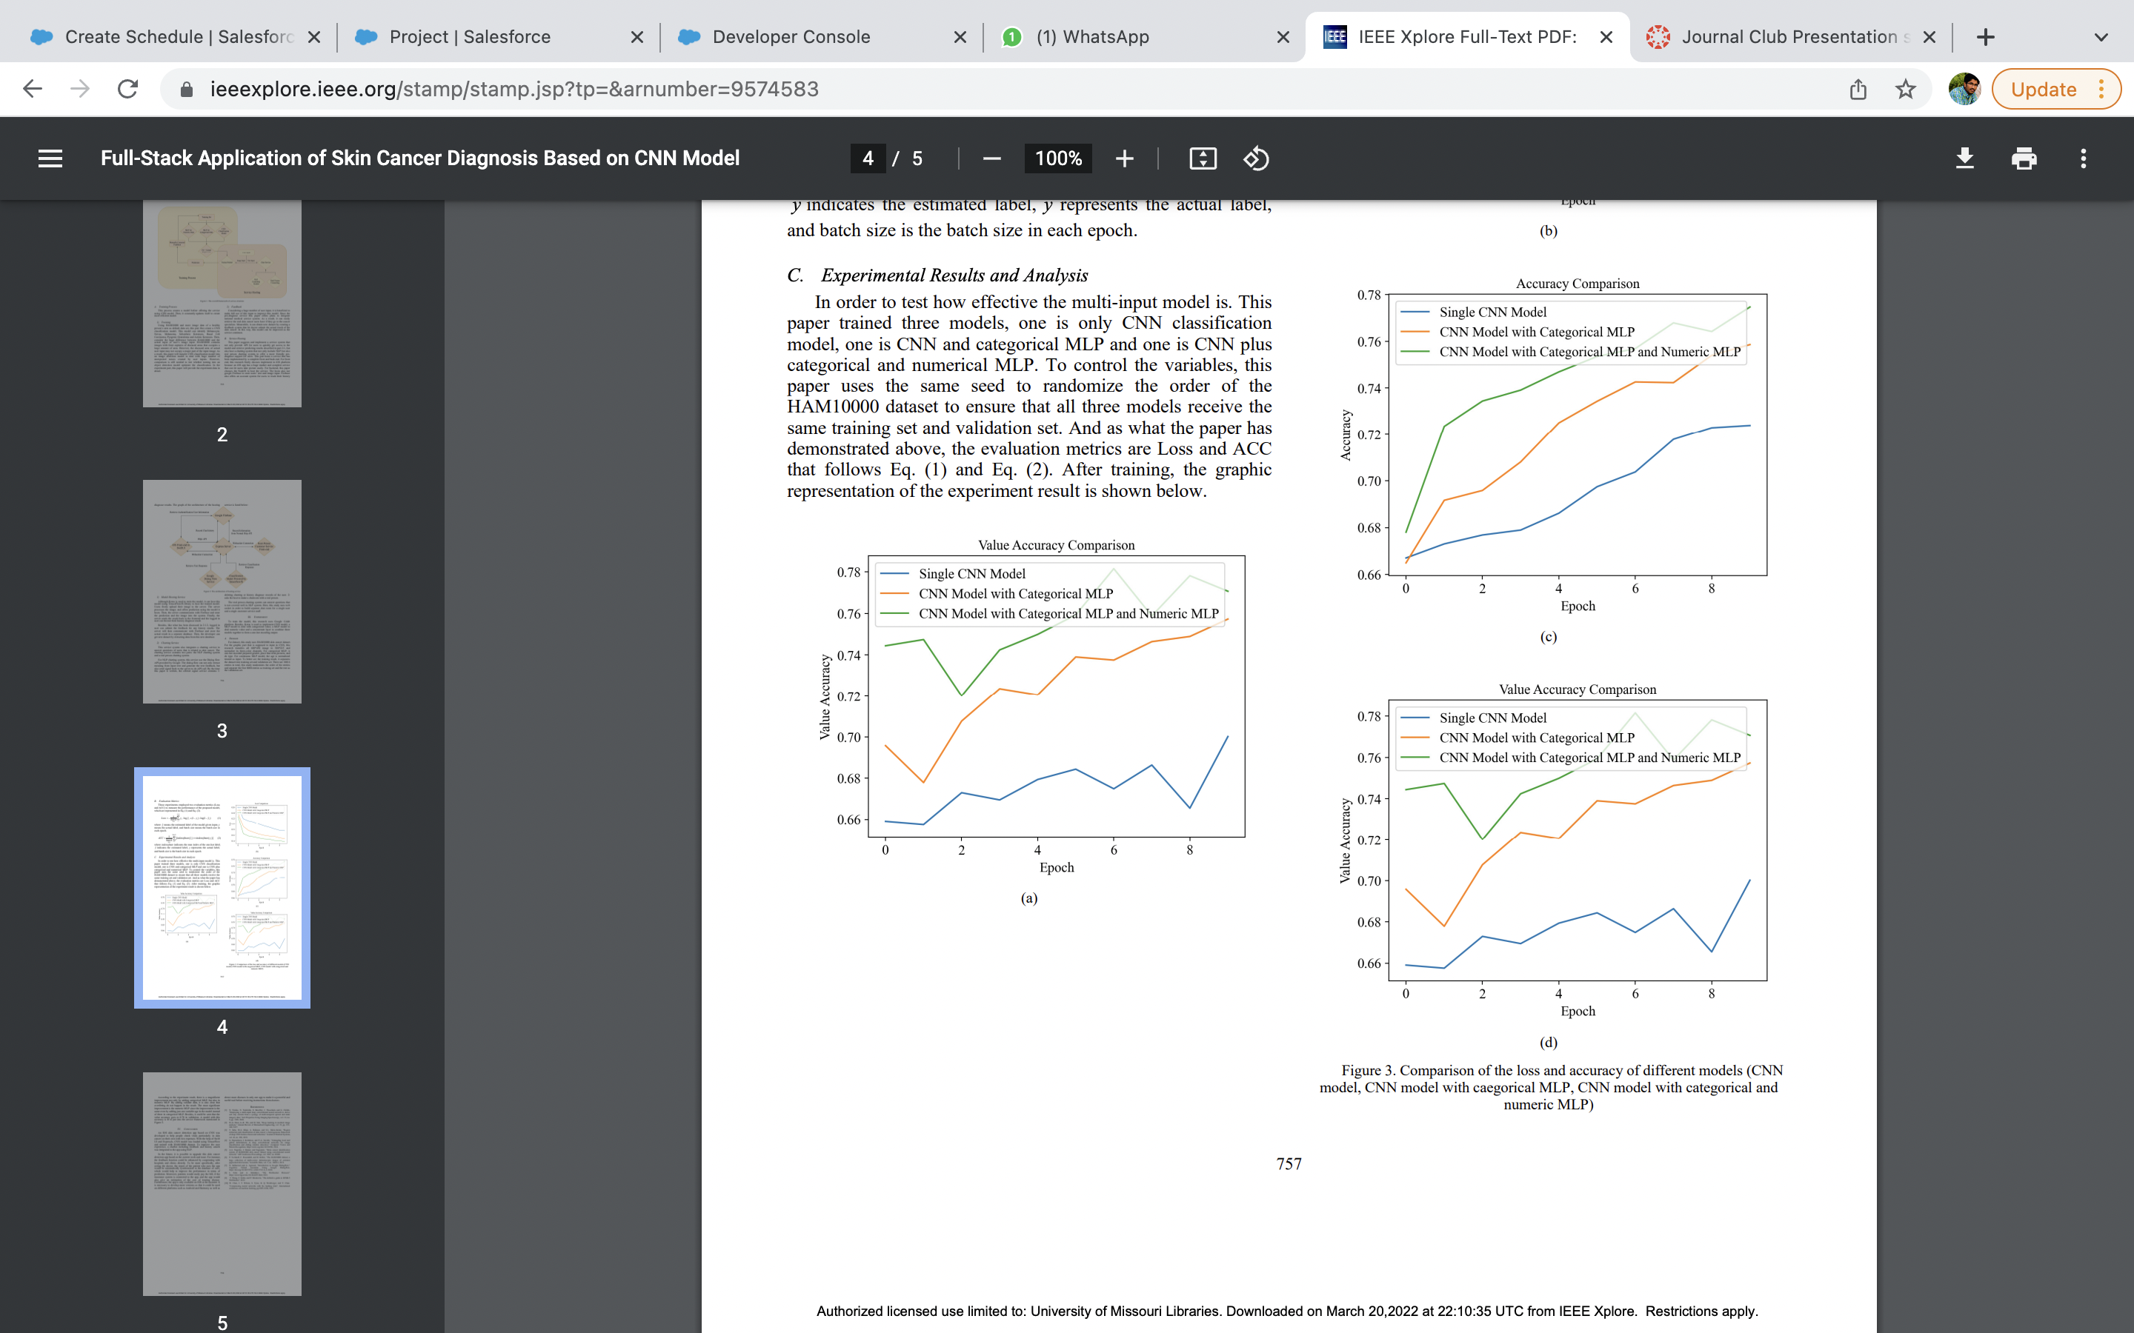
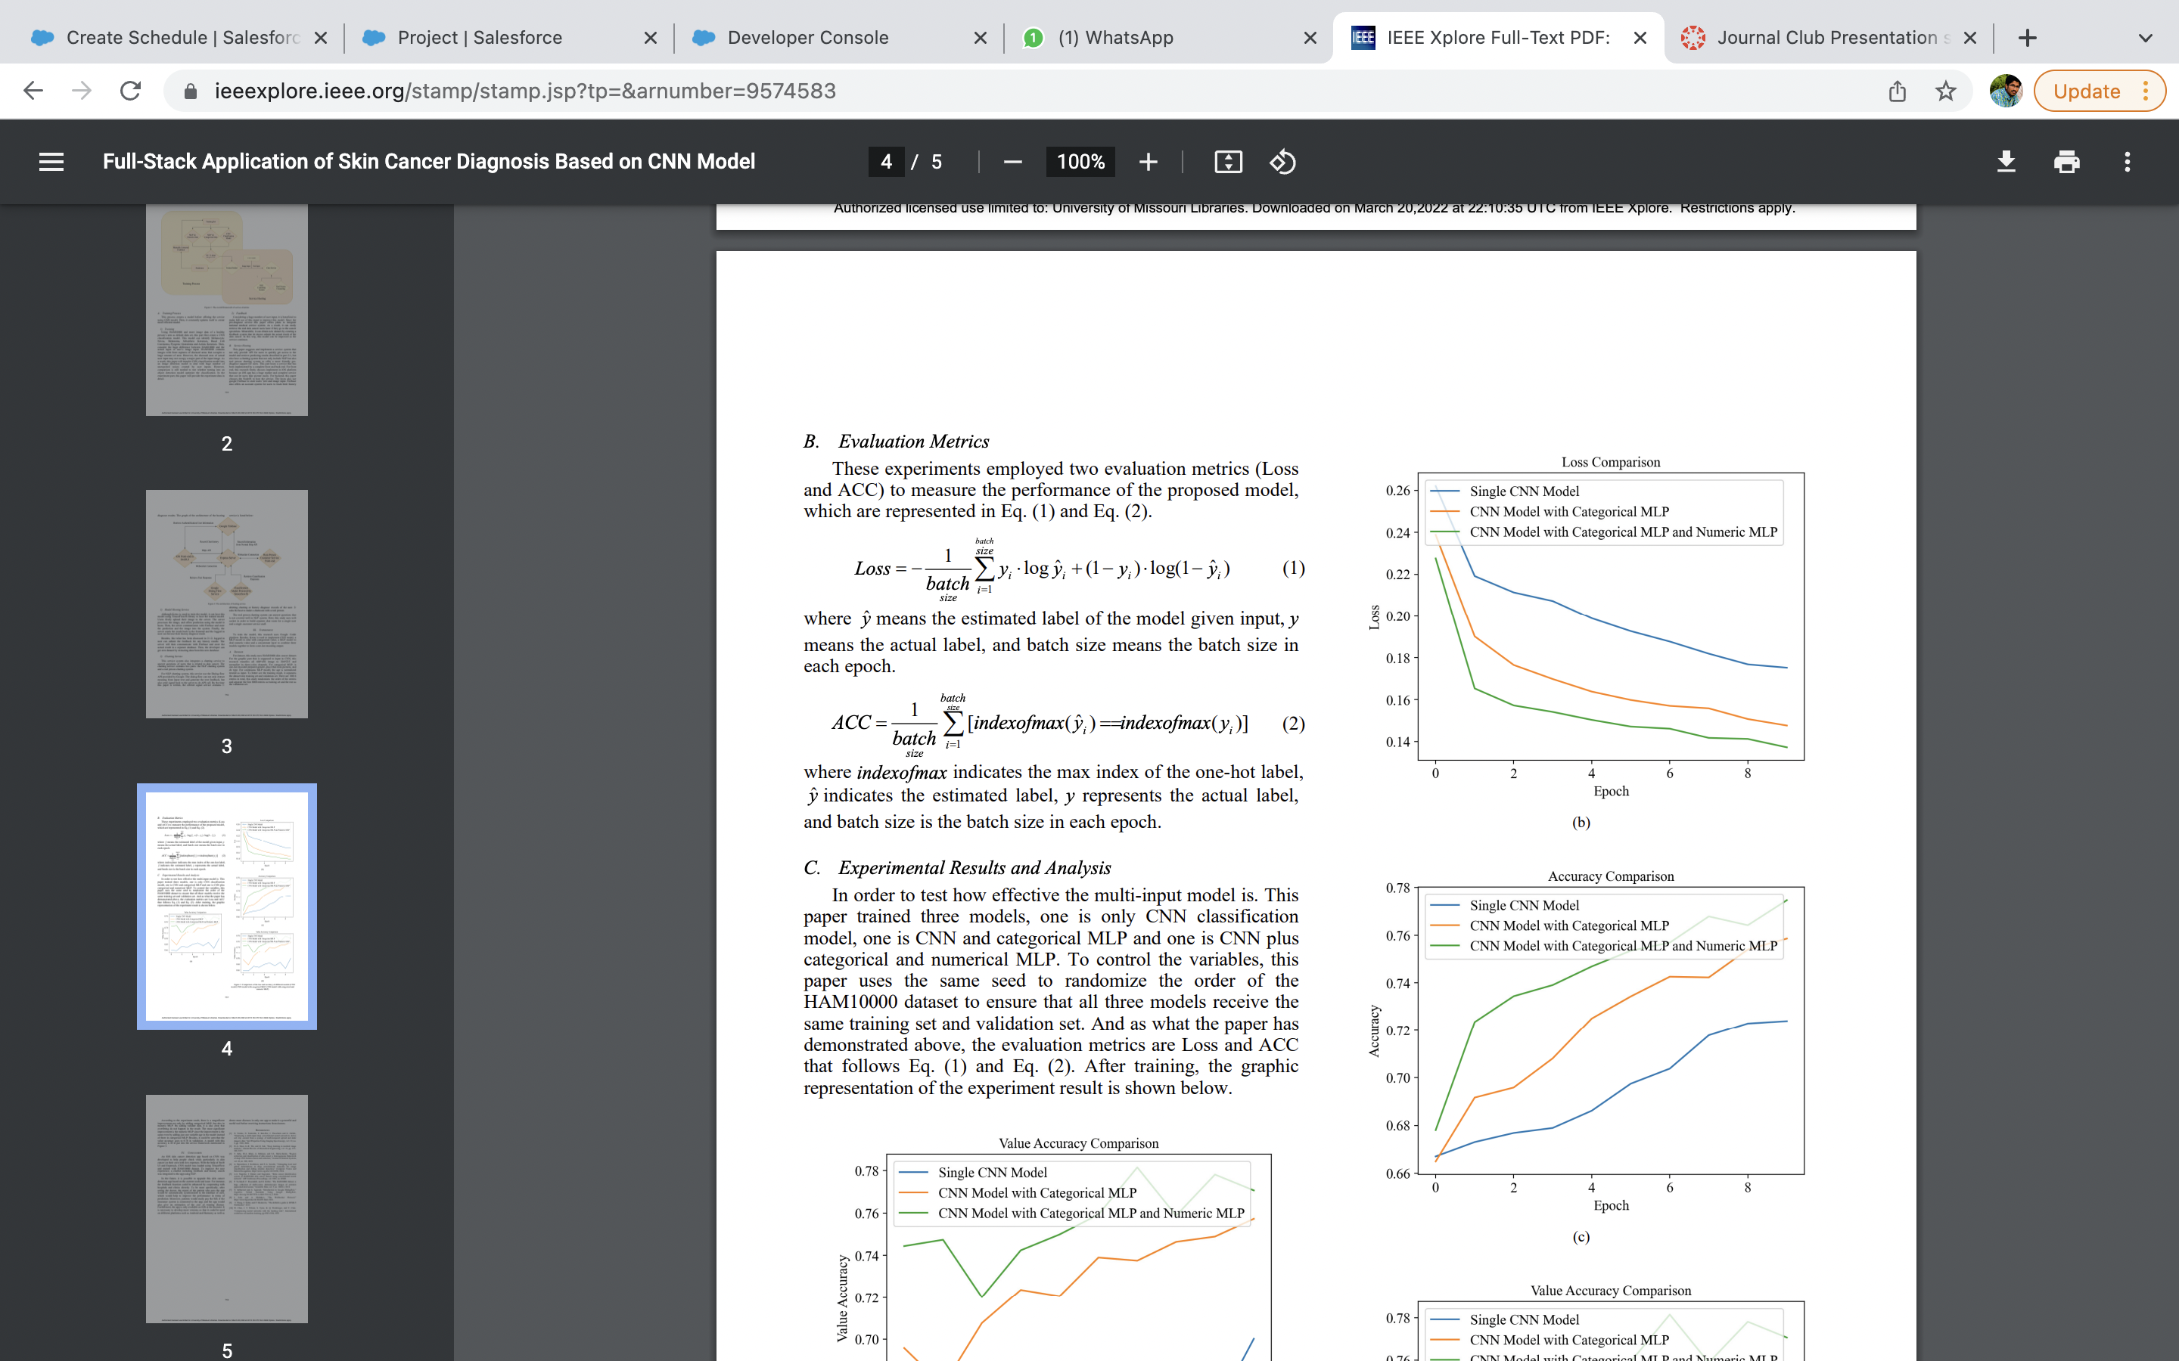

Slide 17
Experimental Results and Analysis :
According to the experiment result, there is a magnificent improvement not only by adding categorical MLP, but also in numeric MLP. By adding validate data, it is also clear that overfitting do not happen in the result.
The most significant improvement is the numeric MLP since the improvement is the same even by adding just one variable age in the model instead of three in categorical MLP. Besides, it could be seen that the value accuracy goes to 0.78 in validation.
A model with this accuracy is fit to put into the service framework mentioned in above figures.

Slide 18
Conclusion:
An IOS skin cancer detection app based on CNN was developed to help people check vitals particularly in skin cancer on their own with low expenses.
With the help of Swift UI and ExpressJs, CNN model was loaded using TensorFlow and trained with HAM10000 dataset.
To improve the user experience, a chatbot including feedback and history search was integrated to the app using NLP.

Slide 19
Future Scope:
In the future, it is possible to upgrade this skin cancer detection app based on the current work and issue. For instance, the feedback function could be enhanced by cooperating with hospitals and clinics directly.
Moreover, patients would easily pay the bill, if the insurance system is connected to the app, and the app would also give an estimation of the cost of treating disease.
Furthermore, the app is only available on IOS now. It is necessary to develop more versions so that it could be used on different platforms such as Android and Harmony as well as detect more diseases in only one app to make it a powerful and useful tool before receiving instructions from doctors.

Slide 20


